Slide 1

Intro to
Programming
With python
Functions:
part 1I
Monday, March 17 2025 TOH210
Notes:
Layout objects pulled from: https://slidesgo.com/
All icons are from: https://thenounproject.com/

Slide 2

functions 2
colab workbook
click for access
found on Moodle under this week

Slide 3

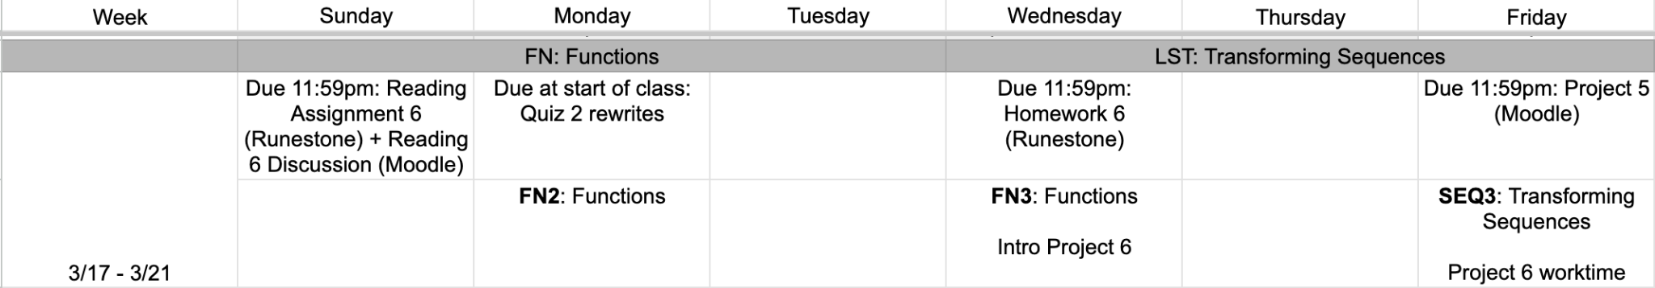
this week
google sheet link

Slide 4
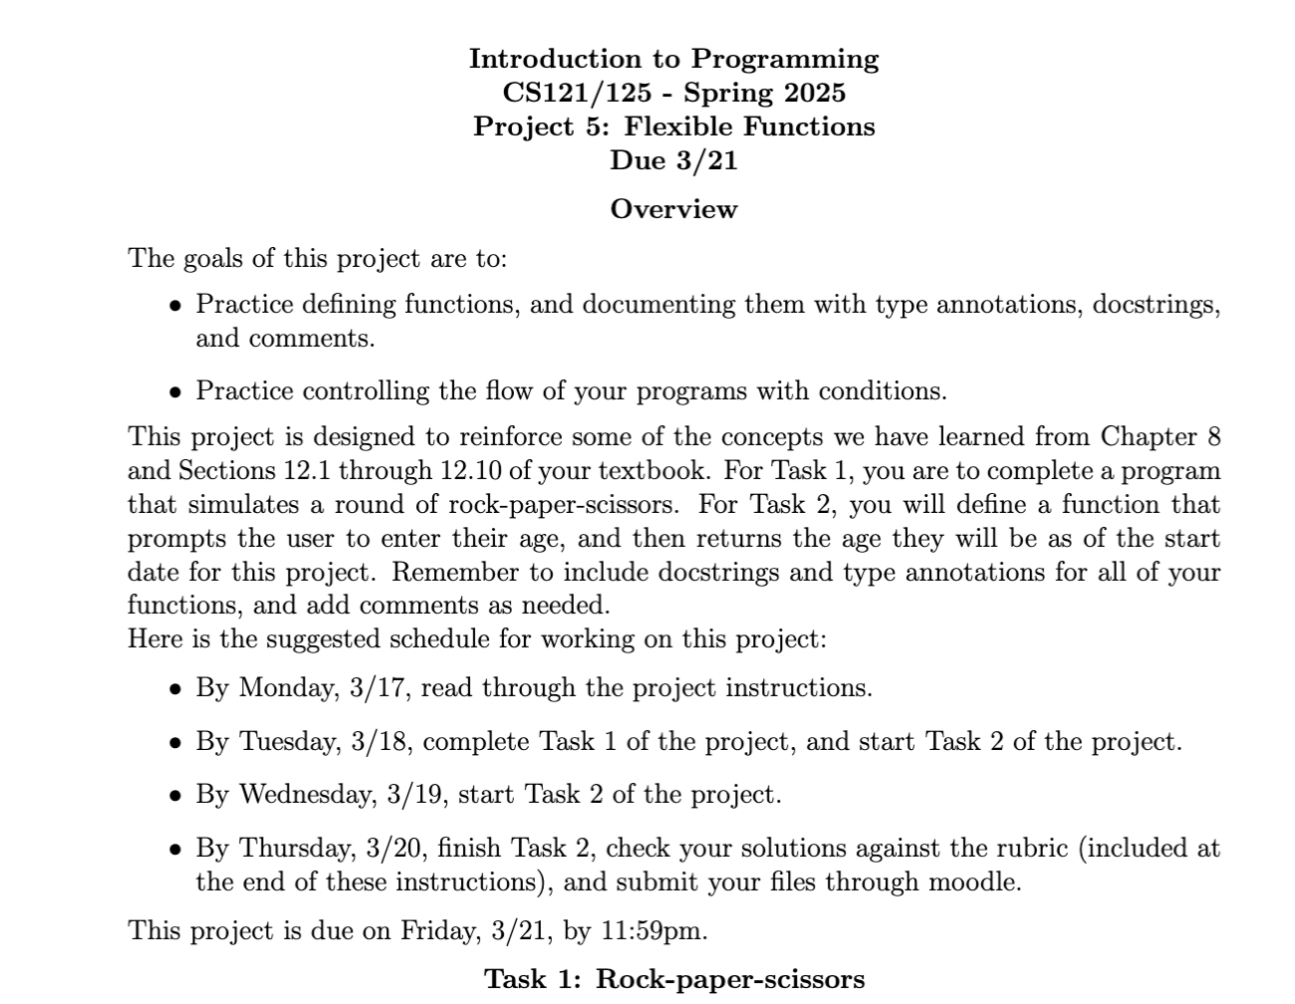
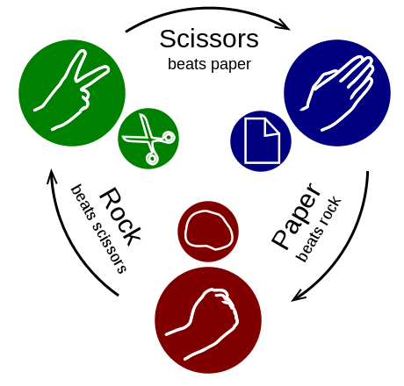

Slide 5
Takeaways from last time
function syntax
def function_name(parameter):
#calculation
return value
function_name(argument)
header
Things you should know:
defining a function
function terminology
body
call

Slide 6


Warm-up
one function
two parameters
Define a function called sum_less_than that takes two arguments: a list and an int. The function returns the sum of all numbers in the list less than the given int. An outline have been provided for you below.
Examples of calling your function are below:
summed_list = sum_less_than([1,14,5,3,8,53,34,23,1,76], 4)
print(summed_list)
summed_list = sum_less_than([1,14,5,3,8,53,34,23,1,76], 49)
print(summed_list)
These should print the following:
5
89
#function definition
def sum_less_than(number_list, biggest_number):
sum = 0 #accumulator variable
#your code here
return sum

Slide 7
data types we’ve seen so far
int 2
float 3.5
str “four”
list [2, 3.5, “four”]
bool True
None no value given
We can use the function type() to figure out the data type

Slide 8
documenting functions
We add documentation to our functions to help another human understand how to use them
type annotations
def sum_less_than(number_list:list, biggest_number:int) -> int:
"""Takes a list of ints (number_list) and an int (biggest_number)
returns the sum of numbers in number_list that are less than
biggest_number."""
sum = 0
for num in number_list:
if num < biggest_number:
sum += num
return sum
docstring
type annotations: specify the types of arguments passed to the function and the return value
docstring: says what the function does, and any information needed to use it

Slide 9
examples: documenting functions
We add documentation to our functions to help another human understand how to use them
def area_of_circle(radius:float) -> float:
"""Takes the radius of a circle as an argument,
and returns the area of the circle"""
pi = 3.141592
area = pi * (radius **2)
return area
def square(number:int) -> int:
"""Takes a number, returns its square"""
return number**2

Slide 10
examples: documenting functions
We add documentation to our functions to help another human understand how to use them
def reverse_string(text:str) -> str:
"""Takes a string, returns a string with the characters in reverse order"""
reversed = “”
length = len(text)
for index in range(length-1, -1, -1):
reserved = reversed + text[index]
return reversed
def list_sum(numbered_list:list) -> int:
"""Takes a list of ints, returns sum of the ints"""
total = 0
for num in numbered_list:
total = total + num
return total

Slide 11
exercise
annotations and docstrings
Grab a partner and whiteboard marker. For each of the following functions: write the header,type annotations, and docstring. You do not need to write the body of the function.
A function called three-average that takes three integers as arguments, and returns their average.
A function called listaverage that takes a list of integers as an argument, and returns their average.
A function called list_through that takes an integer, and returns a list of integers starting at 1 through that argument
Example from previous slide:
def list_sum(numbered_list:list) -> int:
"""Takes a list of ints, returns sum of the ints"""

Slide 12
examples: annotations and docstrings
We add documentation to our functions to help another human understand how to use them
def three_average(num1:int,num2:int,num3:int) -> float:
"""Takes three numbers as arguments, and returns the average"""
def listaverage(number_list:list) -> float:
"""Takes a list of numbers, and returns the average"""
def list_through(number:int) -> list:
"""Takes a number, returns a list of integers starting
at 1 through that number"""

Slide 13
exercise
is even?
Define a function called is_even that takes an integer as an argument, and returns True if the integer is even. Otherwise, it returns False .
Remember to include type annotations and a docstring.

Slide 14
Note (can be confusing): if you call a function in IDLE shell, the return value will be printed.
examples: get_name
Define a function called get_name that takes no arguments. It prompts the user to enter their name, then returns the name they enter.
return: function produced value, can be used in variable assignment
user_name = get_name() will store the string the user entered to variable user_name
def get_name() -> str:
"""Returns name user enters when prompted"""
name = input(“Enter your name: ”)
return name
We can also do a similar function that prints the user’s name rather than return it
print: displays the value as output in the shell
user_name = get_name() will store None to variable user_name
def get_name() -> None:
"""Returns name user enters when prompted"""
name = input(“Enter your name: ”)
print(name)

Slide 15
exercise
print_through
Define a function called print_through that takes an integer number, and prints the numbers 1 through that number with each number on a separate line.
Remember to include type annotations and a docstring.

Slide 16

before next time
Finish workbook
Read Project 5

Slide 17
is even?
print_thru
def is_even(number:int) -> bool:
"""takes an integer as an argument, and returns True if the integer is even. Otherwise, it returns False"""
if number %2==0:
return True
else:
return False
def print_through(number:int) -> None:
"""takes an integer number, and prints the
numbers 1 through that number with each
number on a separate line"""
for num in range(1,number+1):
print(num)

